Slide 1
COMS 4995 SPRING 2021
APPLIED DEEP LEARNING – DETECTING CANCER TUMOR CELLS FROM PATHOLOGY SAMPLES
SYED, HUMAYUN

Slide 2
DATA STORAGE AND PROCESSING
I copied over the files from the shared folder that prof Gordon gave us to my Columbia drive and was able to access the data from there through collab.
I ended up creating patches( of size 299x299) for the set of pathology samples by using the sliding window approach.
For the patches I only took the patches which had atleast 20% tissue.
I classified an image to be cancerous if the center 128x128 image had atleast one cancer pixel.

Slide 3
Under sampling the training data
The data set was very heavily imbalanced it contained significantly more non cancerous images than cancerous images hence I needed to under sample the non cancerous images in the training set to have equal number of cancerous and non cancerous image patches.
Under sampling was done for both the approaches single magnification level image prediction and multi magnification level image prediction.

Slide 4
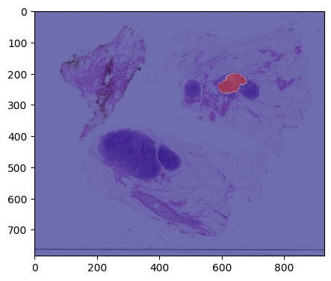
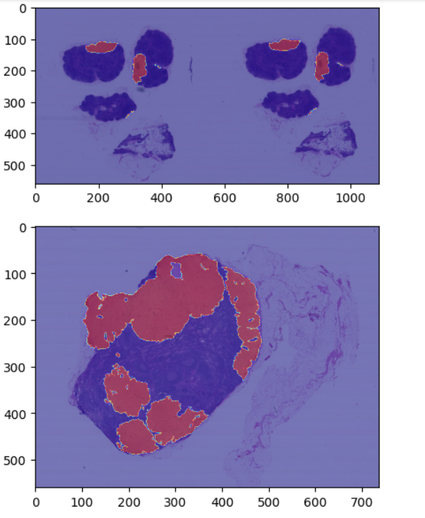
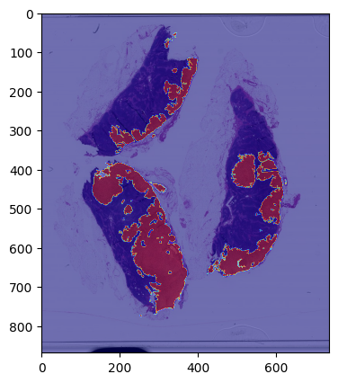
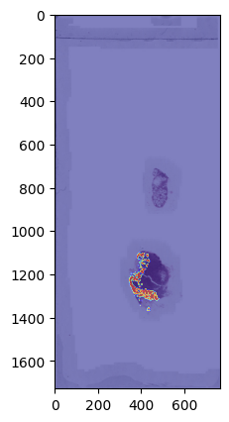
Train slides
'tumor_101','tumor_110’,
'tumor_094','tumor_078’
,'tumor_031'

Slide 5
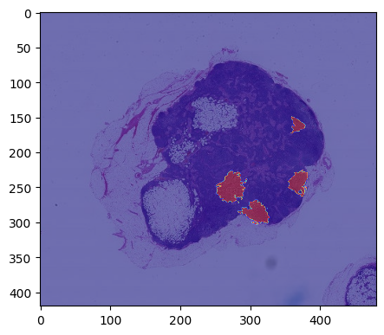
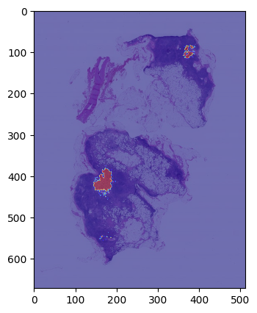
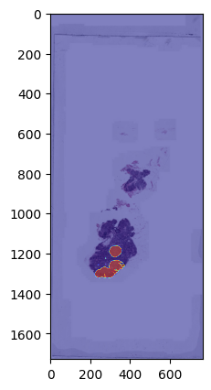
Test slides
'tumor_091','tumor_084','tumor_016'

Slide 6
Single Magnification metrics
Model name | Accuracy | Recall | f1 | roc_auc_score
Inception with image net trained weights | accuracy 0.764472190692395 | 0.7317073170731707 | 0.4195804195804196 | 0.7502467221204004
Inception with data augmentation and image net trained weights | accuracy 0.813280363223609 | 0.5756097560975609 | 0.4176991150442477 | 0.7100913263467895
Inception with fine tuned upper layers | accuracy 0.7338251986379115 | 0.8097560975609757 | 0.41448189762796506 | 0.7667919858389336

Slide 7
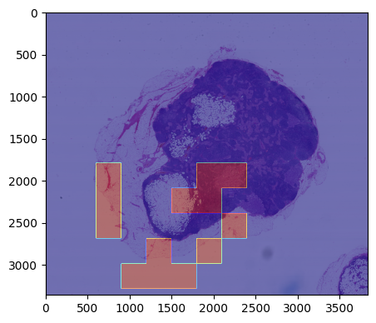
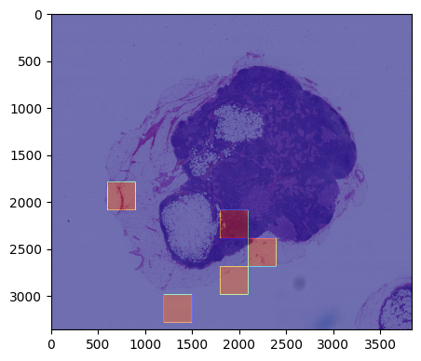
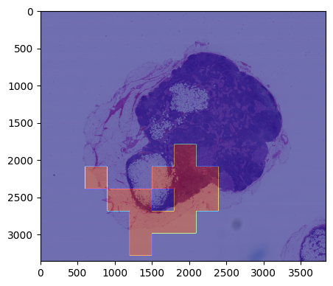
Single Magnification heatmap results
Ground truth
inception_model
inception_augmented_model
inception_fine_tuned_model

Slide 8
Multi Magnification metrics
Model name | description | Accuracy | Recall | f1 | roc_auc_score
multi_magnification_model | Multi Inception with image net trained weights | 0.7678774120317821 | 0.9024390243902439 | 0.4749679075738126 | 0.8262997947898555
fine_tuned_multi_magnification_model | Multi Inception with fine tuned upper layers | 0.6362088535754824 | 0.7219512195121951 | 0.31590181430096054 | 0.6734354684587309
NOTE - I did not use augmentation as it was giving me very bad result for single magnification level .

Slide 9
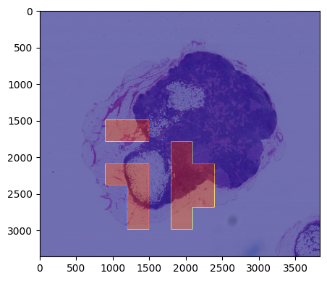
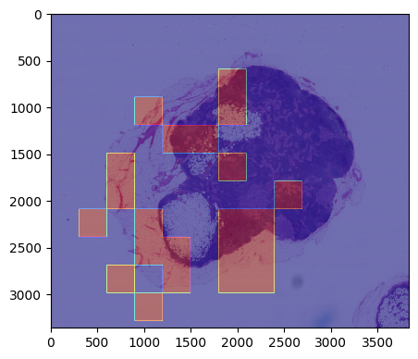
Multi Magnification heatmap example
Ground truth
multi_magnification_model
fine_tuned_multi_magnification_model

Slide 10
Final thoughts
Data augmentation was worsening the results hence I decided to not use data augmentation for multi magnification approach.
InceptionV3 with pre trained imaged net weights gave surprisingly good results however the best results for both single magnification and multi magnification approach were obtained using fine tuned models.
Multi level scaling models in general gave better results than single level zooming.

